Slide 1
Team Amplifire FBC
Taking care of business with Salesforce

Slide 2
Team Amplifire
Evgeny
Sean
Benjamin
Introduction and HR user epic
Sales
user epic
Customer Service user epic

Slide 3
About FBC
A major office supply company working with government agencies. They provide infrastructure (e.g. servers and desktops) and meet mundane office needs (e.g. paper products).
BUSINESS NEEDS

Slide 4
Test code coverage
 | 0-20% | 20-40% | 40-60% | 60-80% | 80-100%
AccountsAndLeads Controller
OpportunitiesPage Controller
CloseOpportunityTask Maker
OrderItemTrigger
OrderItemTrigger Helper
OrderswithProducts Controller

Slide 5
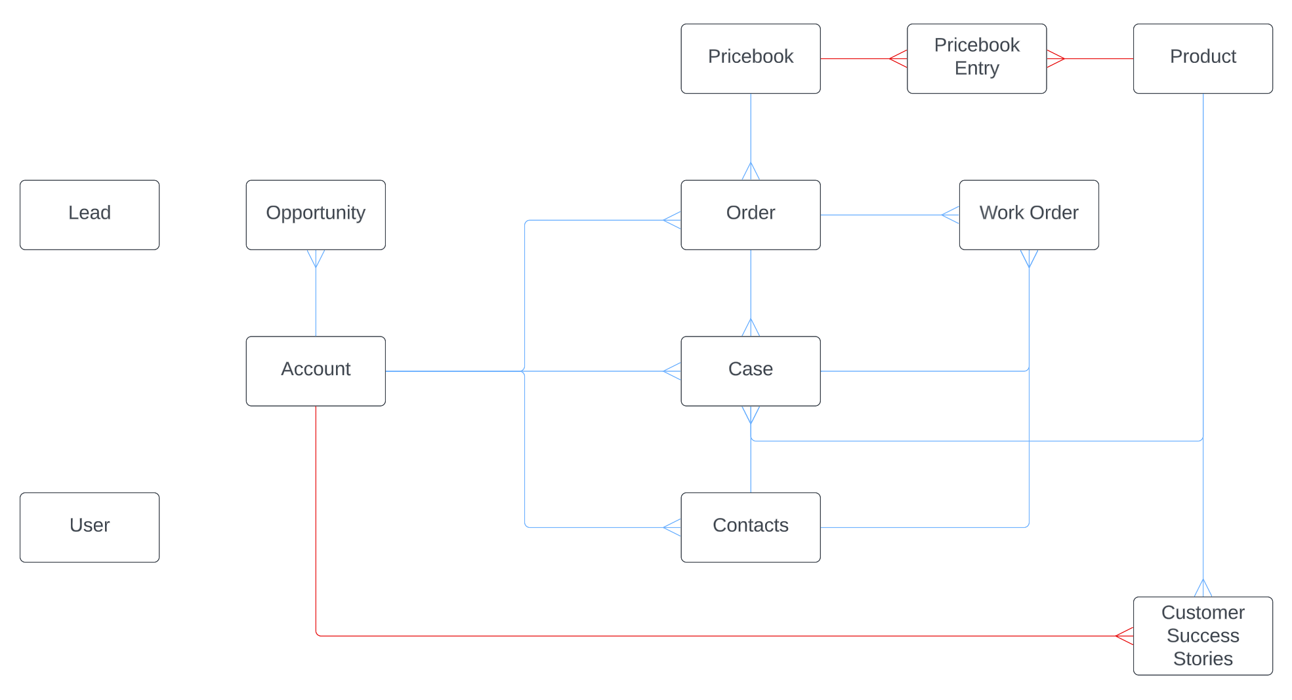
Data Model

